Slide 1

Olist Store Project Presentation
Group 4

Slide 2


Group 4
Vivek Patil
Sreeram P.
Omprasad Kolhal
Sriharitha V.
Ajay Patel

Slide 3
Introduction
Domain: E-commerce
Project Name: Olist Project Analysis

Slide 4
Timeline
Implementation of KPI’s using Excel & MySQL
27-05-2023
Implementation of KPI’s using Tableau
03-06-2023
Implementation of KPI’s using Power BI
Project Kick-off Meeting
11-06-2023
Final Presentation of the Project
13-05-2023
20-05-2023

Slide 5


KPIs
Weekday vs Weekend Payment Statistics
Number of orders with Review score 5 and Payment type as Credit Card
Average number of days taken for order_delivered_customer_date for Pet shop
Average Price and Payment values for customers of Sao paulo city
Relationship between shipping days vs Review scores

Slide 6

Weekday Vs Weekend (order_purchase_timestamp) Payment Statistics
KPI 1

Slide 7
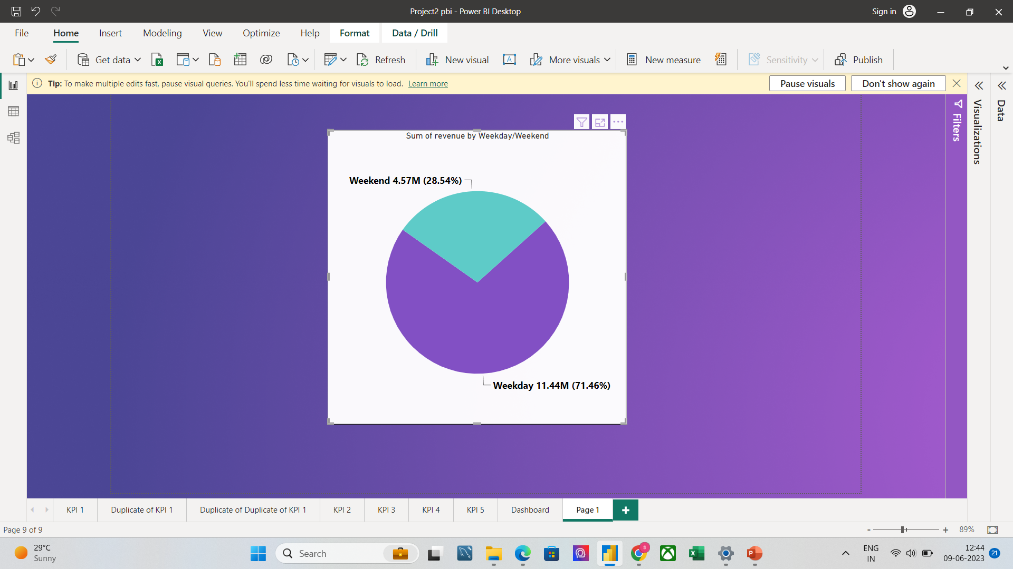
Weekday Vs Weekend Payment Statistics
No of orders: Weekdays-70875, Weekends-28566
Revenue Generated in Weekdays 11.44m and for Weekends is 4.57m.
On Weekends and on Weekdays almost 73.9% of the order payments are done through using Credit Cards and 19% payments are using Boleto.
Almost 72.59% of orders are paid within 1-3 instalments and 46.5% of that are done with credit cards and about 19% are done with Boleto.
Only 5.4% are paying with 10 and more instalments.

Slide 8
Number of Orders with review score 5 and payment type as credit card
KPI 2

Slide 9
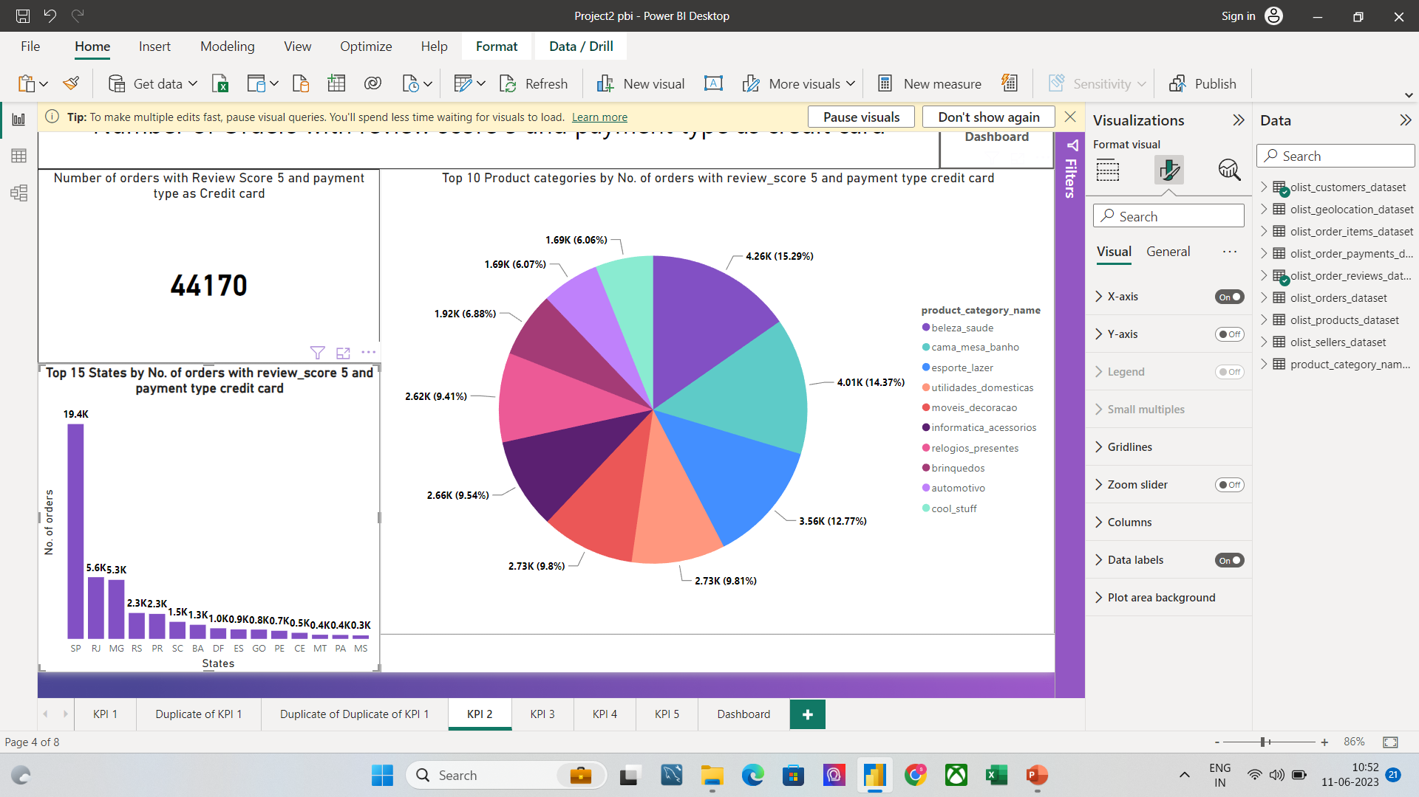
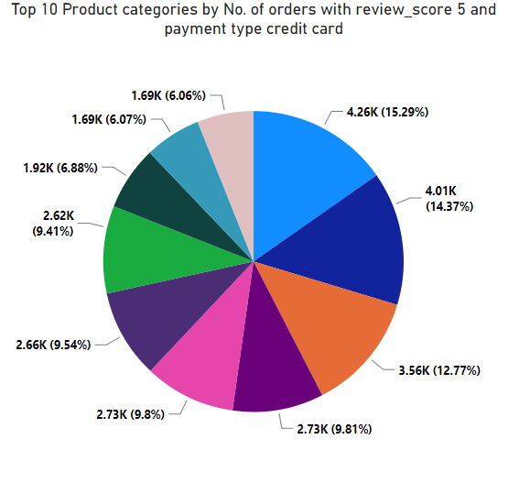
Number of Orders with review score 5 and payment type as credit card
Total number of orders are 99441
Review score ranges from 0 to 5
Review score 5 has maximum orders 57076
Review score 2 has least orders 3148
Payment type credit card has maximum orders 76505
Least orders are by debit card 1528 excluding not defined and null values
Overall number of orders with Review score 5 and Payment type as Credit card are 43981

Slide 10
Average number of days taken for order_delivered_customer_date for pet_shop
KPI 3

Slide 11
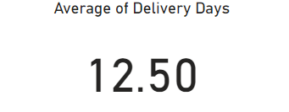
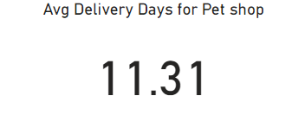
Average number of days taken pet_shop
Average of Delivery days is 12.50
Average delivery days for pet shop is 11.31
In product category “Artes e artesanato” takes minimum no. of days to order as comparing with the other product category.
In state wise “Sao Paulo” takes the minimum No. of days to order as comparing to the other states.
Average No. of days for the Weekday is 12.54 and for Weekend is 12.38.
The company must identify those products that take longer time to deliver. And compare it with the fast delivery product categories. This comparison gives idea about where these bottom categories are lacking so that they can improve them.

Slide 12
Average price and payment values from customers of sao paulo city
KPI 4

Slide 13
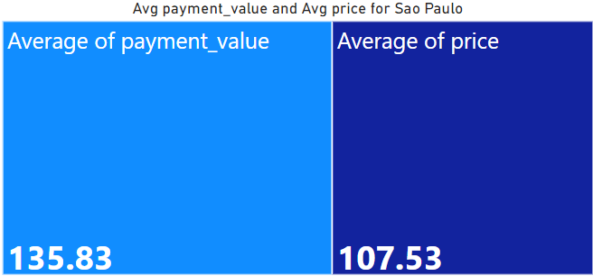
Average price and payment values from customers of sao paulo city
The Average price from customers of Sao Paulo city with 107.53
The Average payment value from customers of Sao Paulo city with 135.83
Pcs is having highest product category w.r.t to Average price & Average payment value
Pianco is the city which is having highest Average price and payment values
The Average of price on weekday is highest with 134.85 comparing to weekend with 80.66
The Average of payment value on weekday is highest with 171.38
The Average of payment value on weekend is 116.19

Slide 14
Relationship between shipping days (order_delivered_customer_date - order_purchase_timestamp) Vs review scores
KPI 5

Slide 15
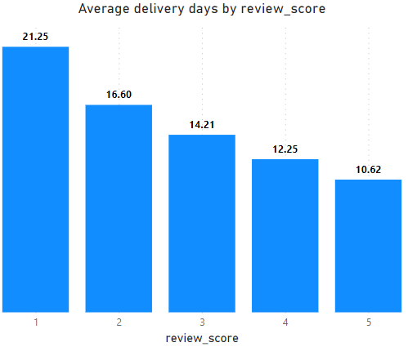
Relationship between shipping days Vs review scores
Avg. Delivery days for review score 5 are 10.62 and for review score 1 are 21.25.
Most No. of orders, review score 5 accounts for 59563 & least No. of orders, review score 2 accounts for 3327.
No. of orders increasing on YOY basis with 2018 leading the most.
Payment value of orders for review score 5 accounts for 56% of total payment value, and for review score 2 accounts for 3.4%.

Slide 16
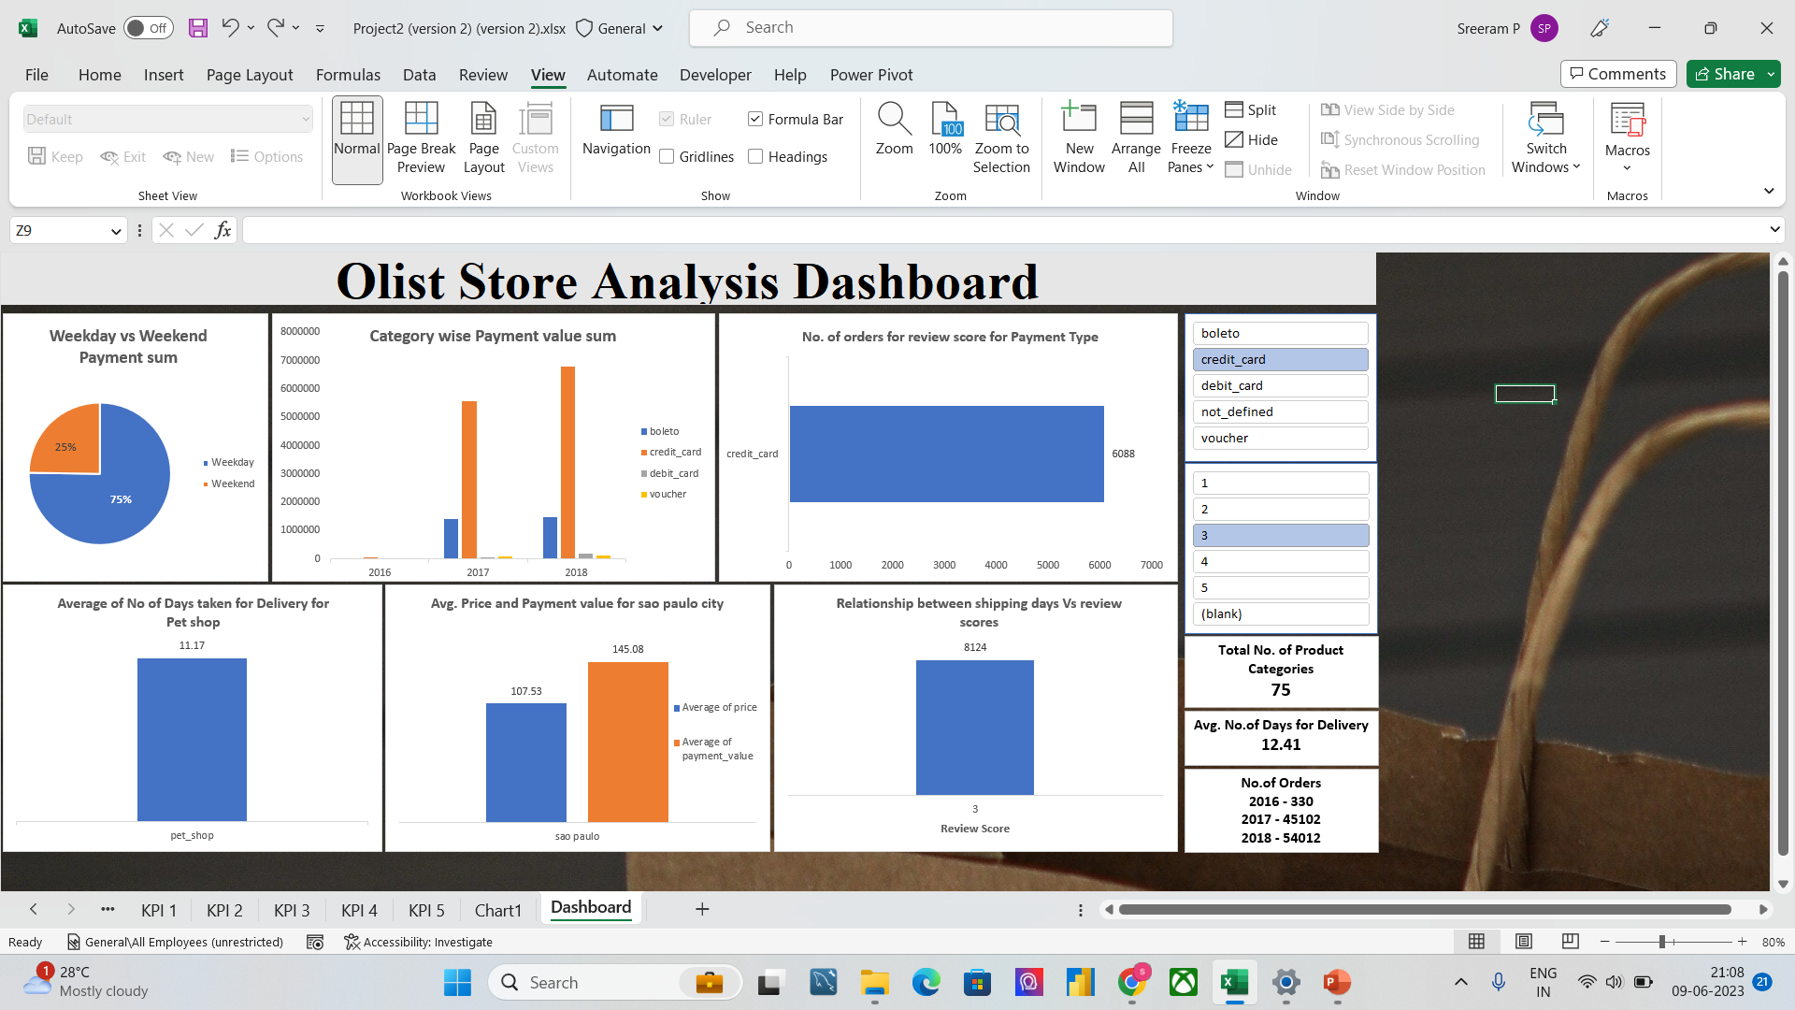
Excel Dashboard

Slide 17
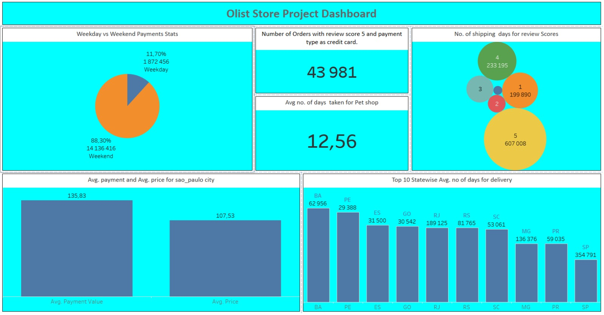
Tableau Dashboard

Slide 18
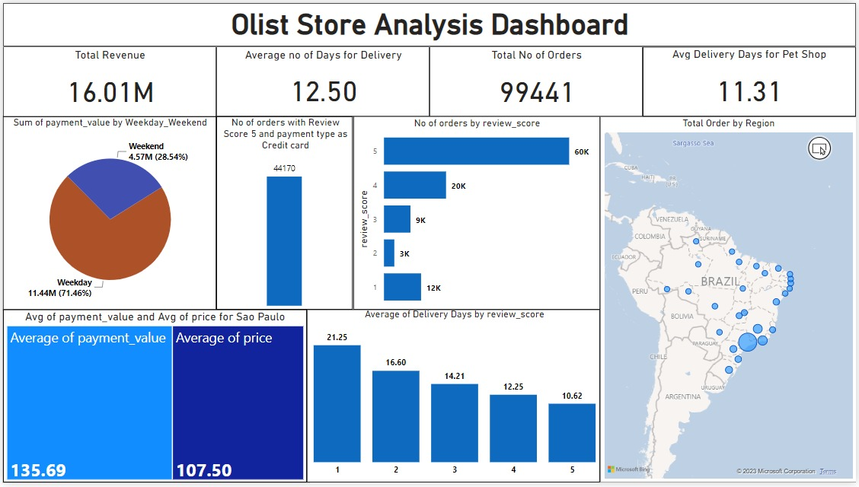
Power Bi Dashboard

Slide 19



THANK YOU
Group 4

